Slide 1


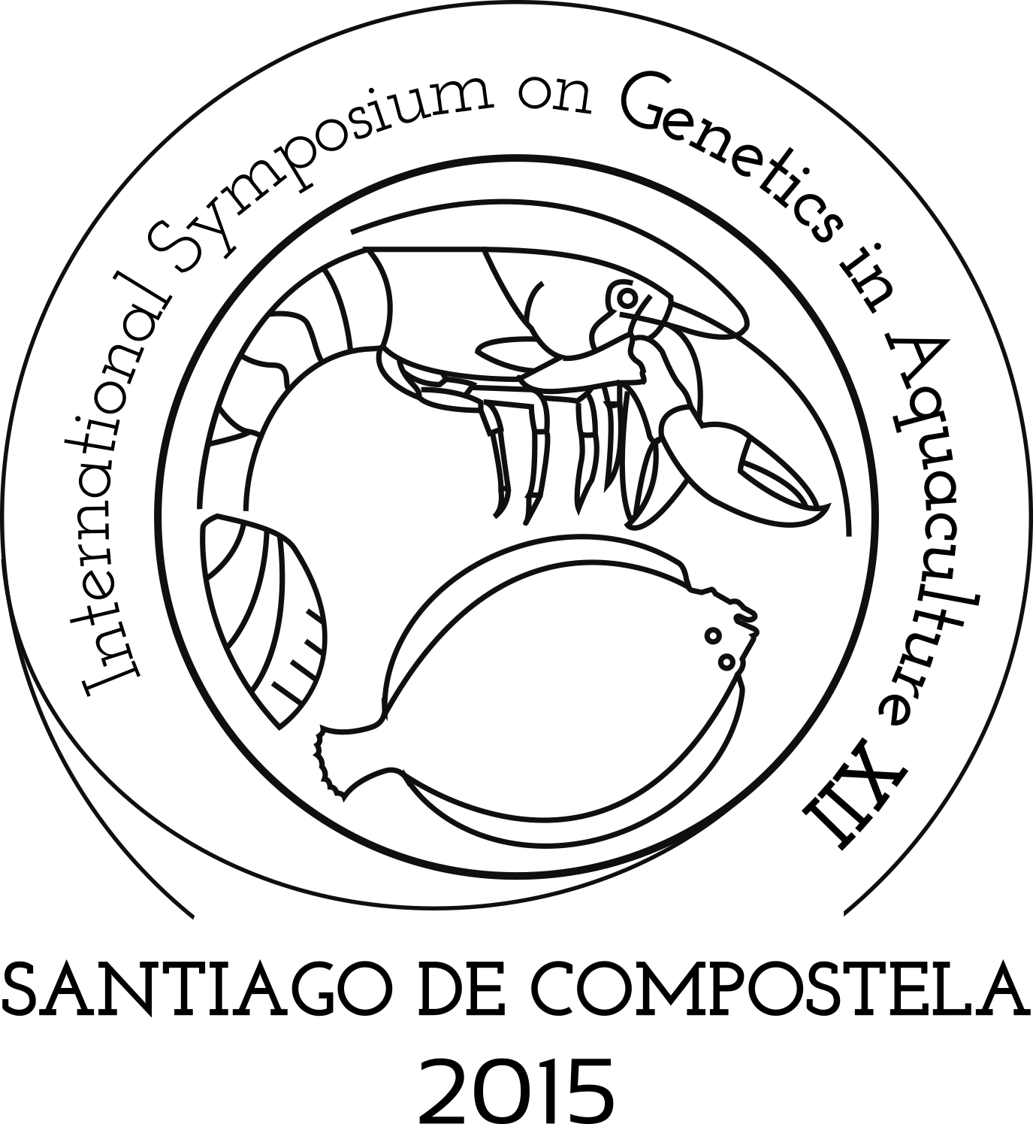

Slide 2
Some notes and recommendations for a succesful meeting

Slide 3

BROADCASTING OF OPENING CEREMONY
http://tv.usc.es/directo2.html

Slide 4

ISGA XII FIGURES: PARTICIPANTS
236 participants

Slide 5
ISGA XII FIGURES: CONTINENTS

Slide 6
ISGA XII FIGURES: 38 COUNTRIES

Slide 7
ISGA XII FIGURES: INSTITUTIONS

Slide 8
ISGA XII FIGURES: RESEARCH AREAS

Slide 9
ISGA XII FIGURES: TAXONOMIC GROUPS

Slide 10
ISGA XII FIGURES: 54 SPECIES

Slide 11
ISGA XII FIGURES: PRESENTATION TYPE

Slide 12
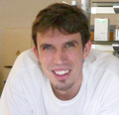
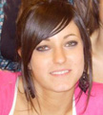
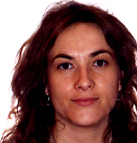
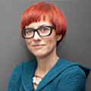
PERSONAL FOR ASSISTANCE
ORAL PRESENTATIONS
Diego Robledo
Xoana Taboada
GENERAL INFORMATION
Mónica Otero
María Pérez

Slide 13
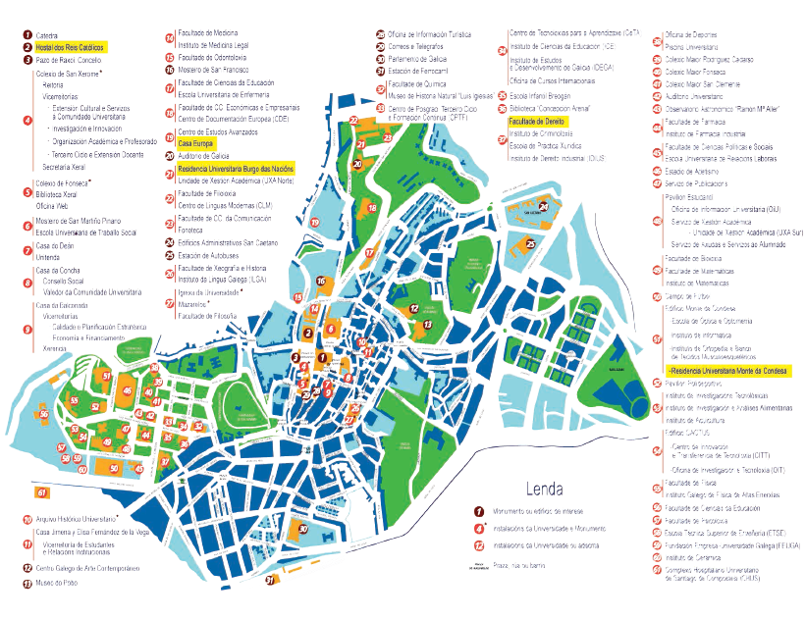

INSTRUCTIONS AND RECOMMENDATIONS
City center
20 min
South Campus
LAW FACULTY

Slide 14
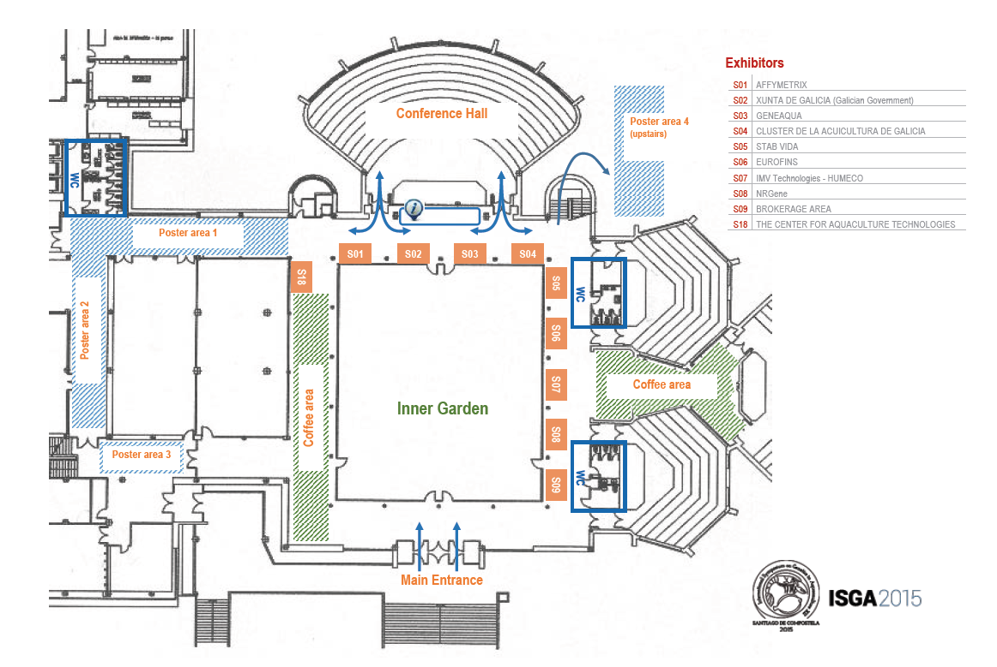
INSTRUCTIONS AND RECOMMENDATIONS
wc
TO LUNCH
COFFE
COFFE
COFFE

Slide 15
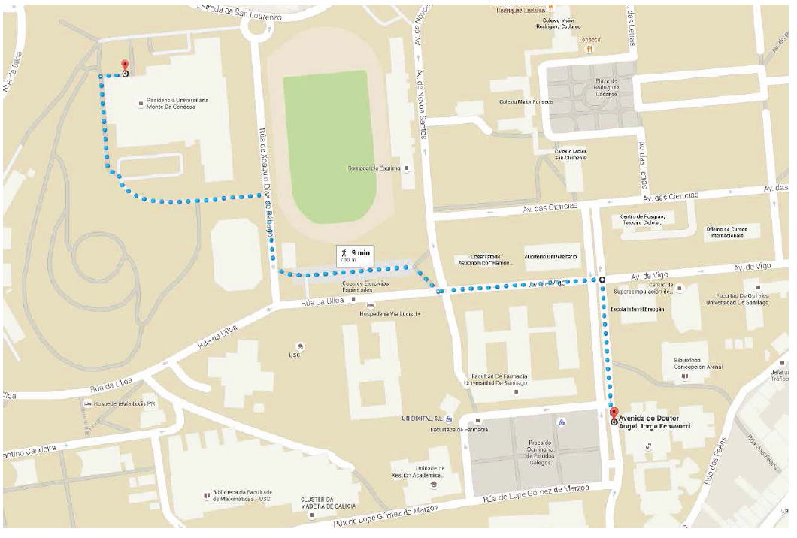
INSTRUCTIONS AND RECOMMENDATIONS
LUNCH VENUE
9 MIN
MEETING VENUE

Slide 16
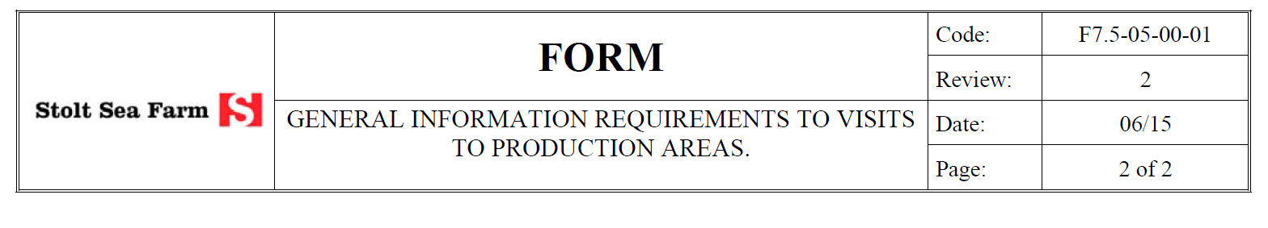
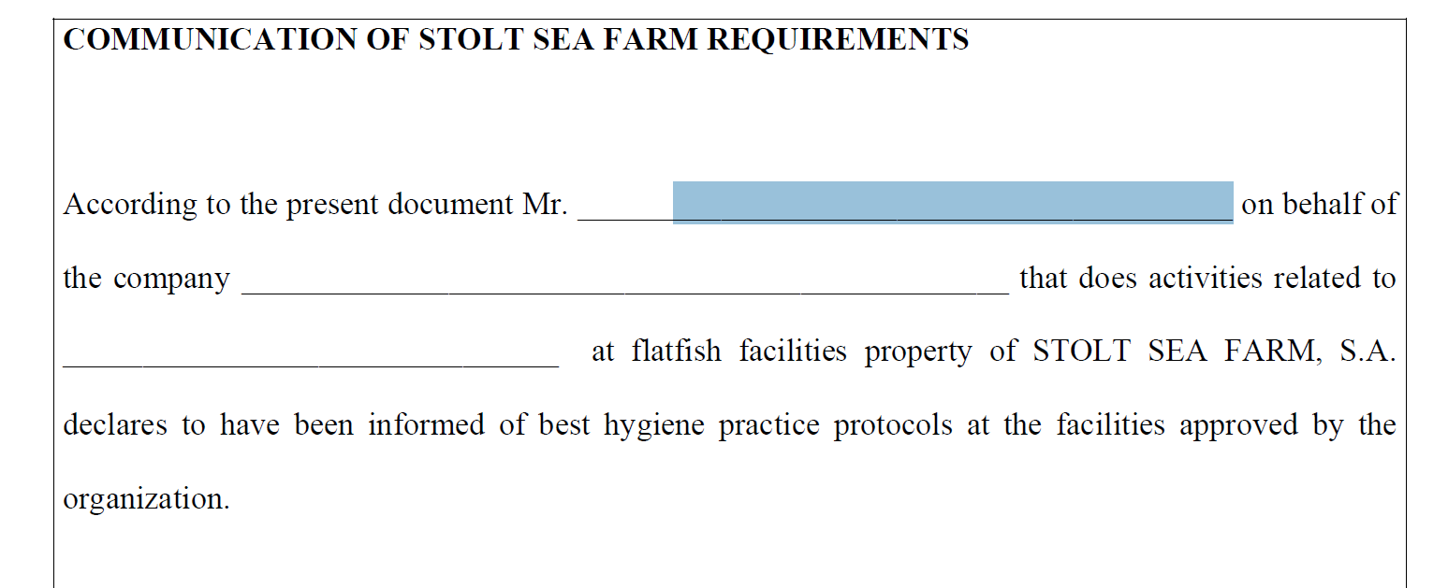
ISGA EXCURSIONS: VISIT TO STOLT SEA FARM SA
PAULINO MARTÍNEZ
UNIVERSITY OF SANTIAGO
VISIT GENETICS CONGRESS

Slide 17
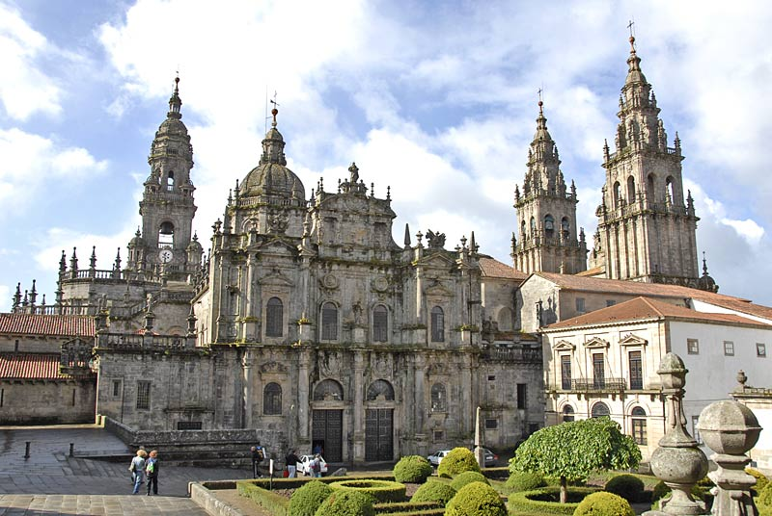
ISGA EXCURSIONS: VISIT TO SANTIAGO
Sign in the list at the registration desk before Wednesday

Slide 18
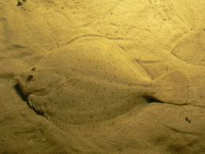
THE HISTORY OF AQUACULTURE AND BREEDING PROGRAMS IN SPAIN
Paulino Martínez
University of Santiago de Compostela

Slide 19
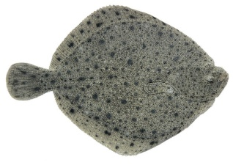
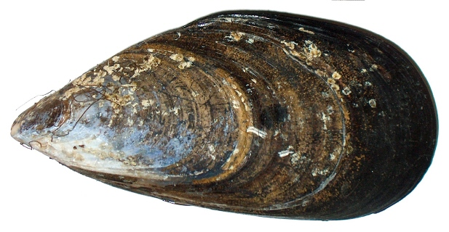
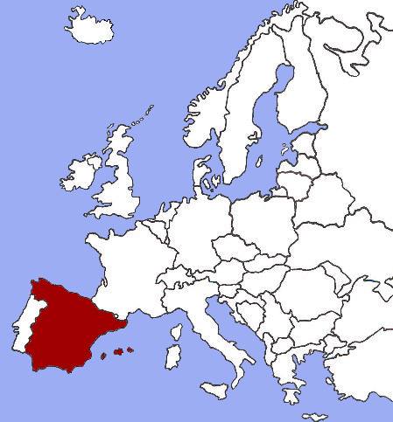
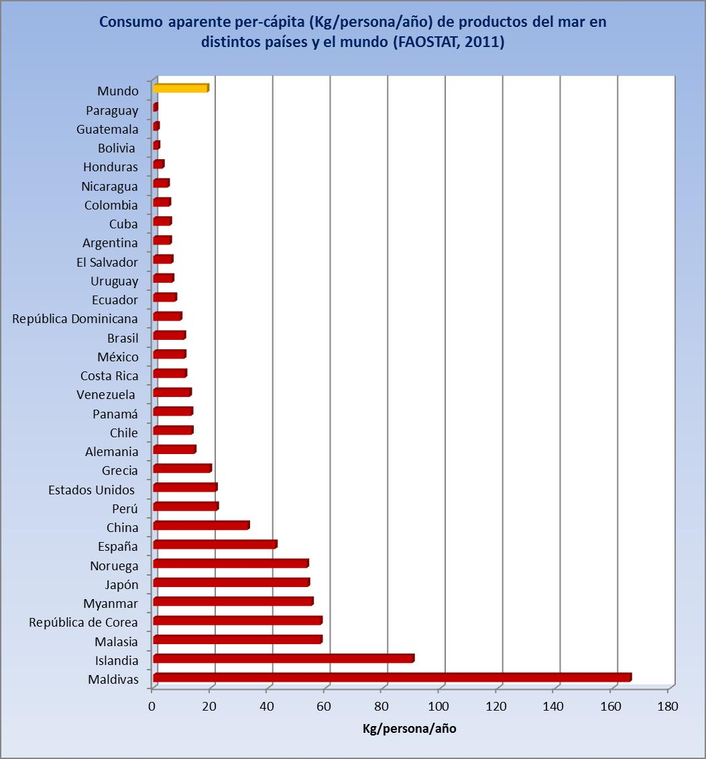
SEAFOOD PRODUCTION IN SPAIN
ATLANTIC OCEAN
MEDITERRANEAN SEA
19th Spain ~ 300,000 tons
8th Spain 41 kg/person/year

Slide 20
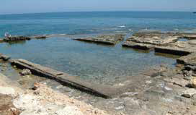
ROMAN SEAFOOD
Romans, and especially the upper class, appreciated very much seafood. Since century II BC Romans reared and grew fish and mollusk in captivity using nurseries like the one shown in this slide from coastal remainders in Tarragona (Spain). Such facilities reflected the wealth of the upper Roman classes

Slide 21
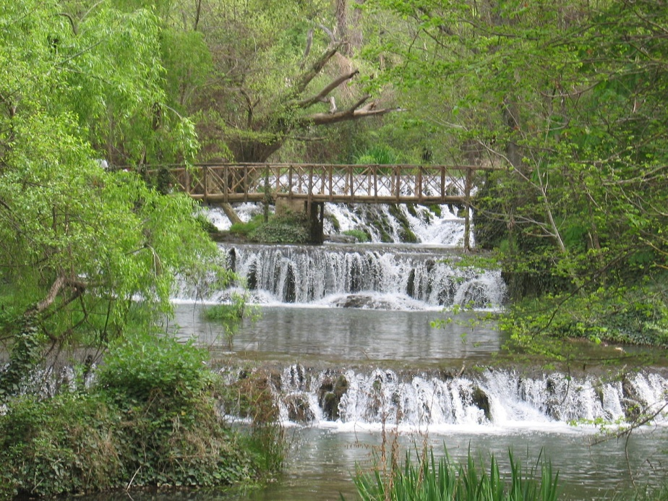
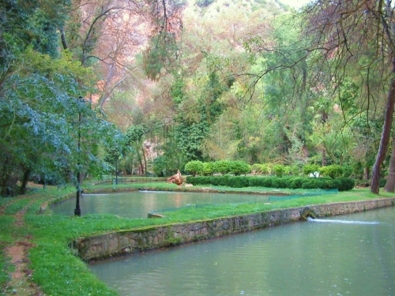
THE FIRST FISH FARMS: ABBEYS AND MONASTERIES
The first European aquaculture facilities appear in the Middle Age associated to monasteries and abbeys where fish, especially carps and trouts, were reared. The first Spanish fish farm is founded in 1870 in the Monasterio de Piedra (shown in this picture). By that time, the Spanish Government was concerned about the declining of fish populations in rivers, streams and lakes. The initial objectives of this fish farming centre were repopulation with freshwater trout (Salmo trutta), teaching and research of freshwater ecosystems.

Slide 22
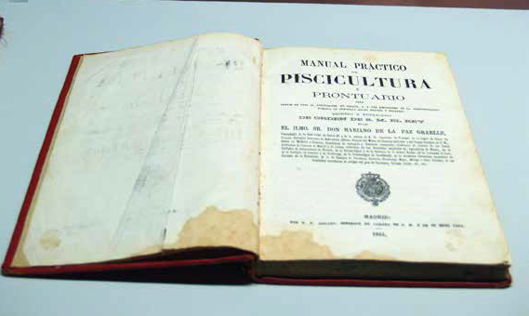
FIRST STEPS IN FISH FARMING
Practical fish farm manual in Spanish for employees of public administration working in fresh and salt water. Mr. Mariano de la Paz Graells. Madrid. 1844.

Slide 23
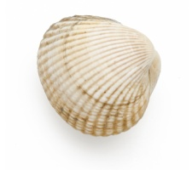
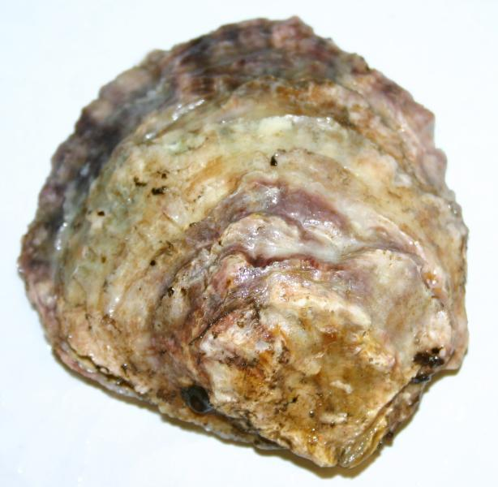
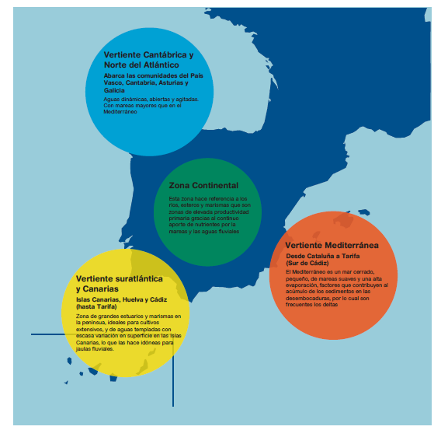
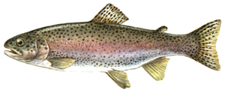
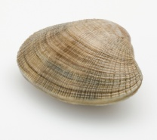
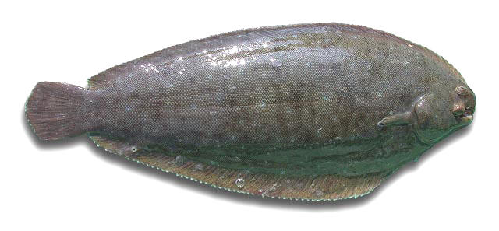
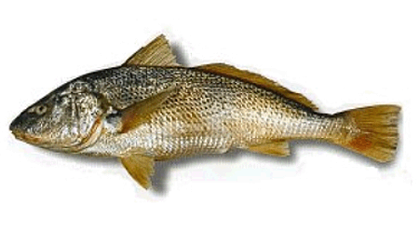
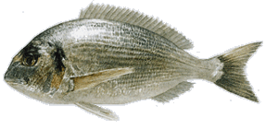
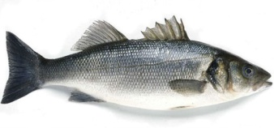
MAIN AQUACULTURE REGIONS IN SPAIN
Long and rich hydrographic system
Cockle
Flat oyster
-
GaliciaN Region
Clam
Mussel
Turbot
Sole
Tª
Cont.
Region
Meager
Protected and highly productive ecosystems
Medit. Region
+
Sea bream
S. East Atlantic Region
Sea bass
Sole
-
Closed sea, narrow tide range, warm temperatures in summer
Tª
salinity
+
Sea bream
Warmer water. Shallow waters enables extensive culture in Andalucia

Slide 24
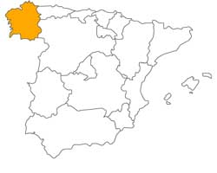
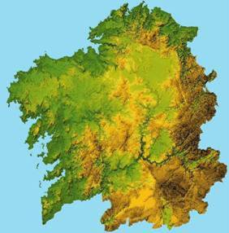
GALICIAN AQUACULTURE
The high importance of Galician Aquaculture is related to its high primary production in the Galician Rias (250 g C/ m² /year) and its long coast (1200 km: ¼ of the Spanish coast, but only 1/10 of the Spanish territytory)

Slide 25
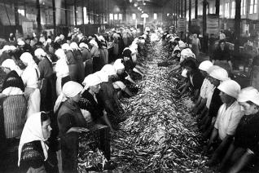
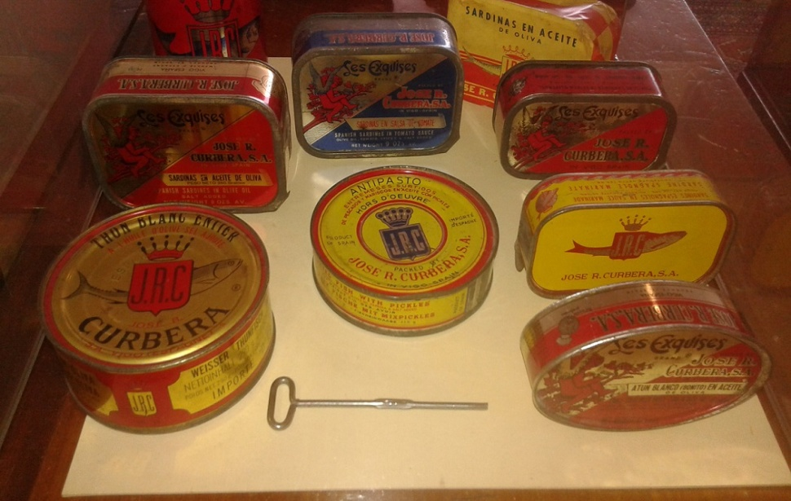
GALICIAN SEAFOOD RICHNESS
Photo Museo Pontevedra
Photo Historia de la Conserva (bluscus.es)
Galician seafood richness is recognized from long time ago. In the 18th century settles in Galicia an important canned and brine industry, which expands in the 19th and 20th centuries with more sophisticated ways of production and technology associated with food conservation

Slide 26
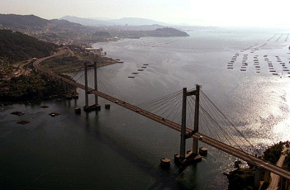
GALICIAN AQUACULTURE
RÍA (ESTUARY) OF VIGO
Fisheries/Aquaculture sector represents 10,7 % of the Galician economy
Fisheries, mollusk collection and aquaculture produce more than 1.000 mill.€/year
Galician employment associated with sea-production: 25.000 direct employments

Slide 27
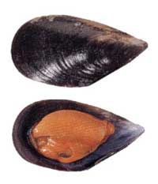
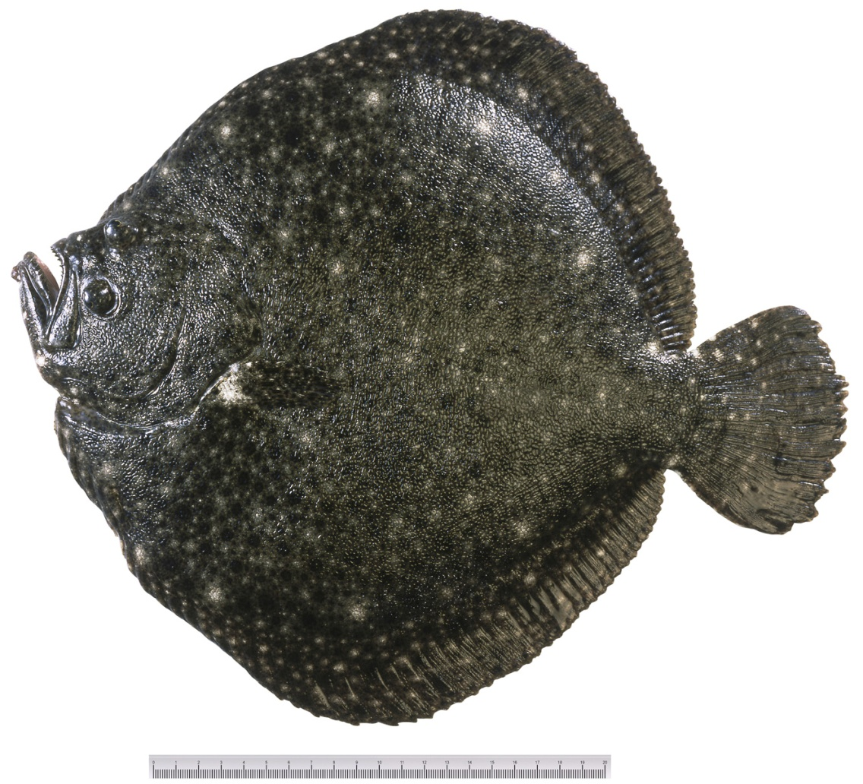
Main Galician Aquaculture species
Turbot
( Scophthalmus maximus)
~10,000 tonnes
Mediterranean mussel
( Mytilus galloprovincialis)
~250,000 tonnes

Slide 28
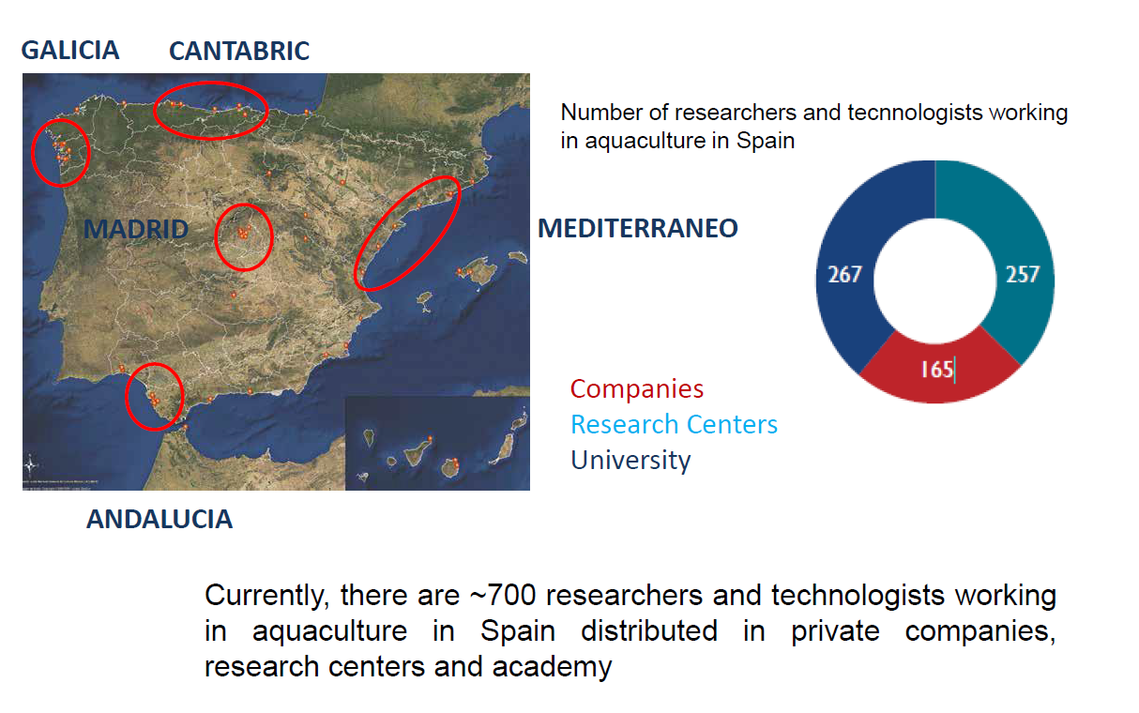
AQUACULTURE RESEARCH
MEDITERRANEO
CANARY ISLANDS

Slide 29
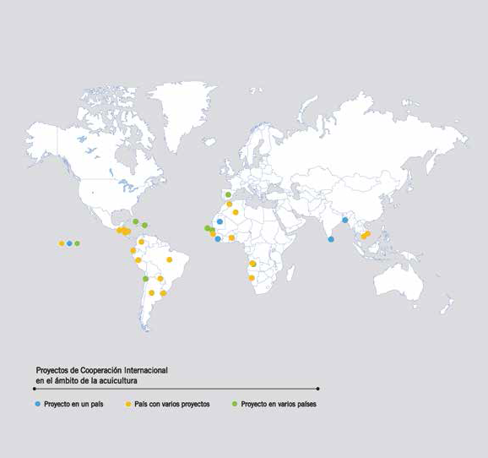
WORLD AQUACULTURE ASSISTANCE
Project in one country
Project with more than one country
Project in several countries

Slide 30
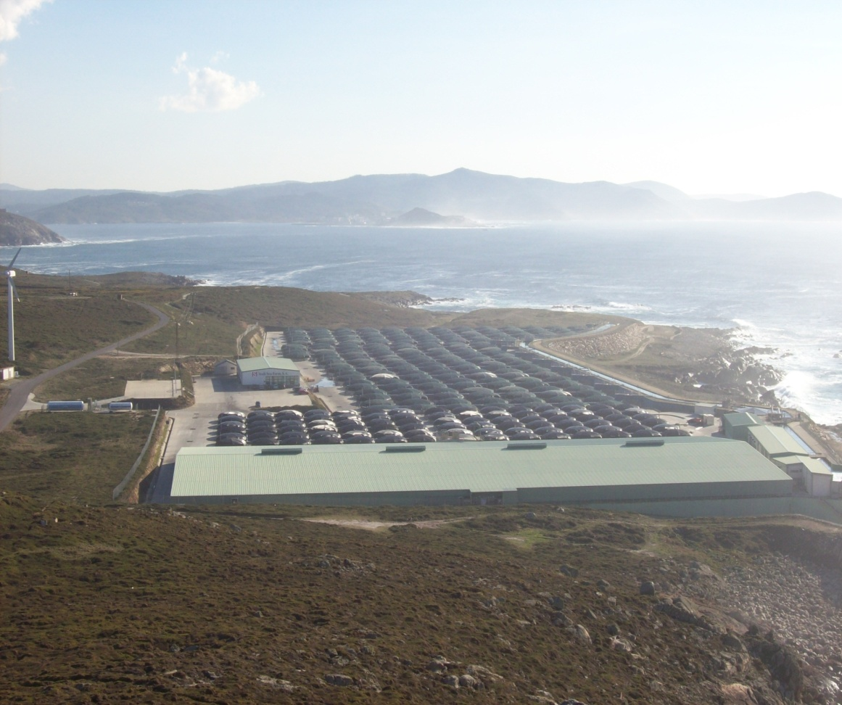

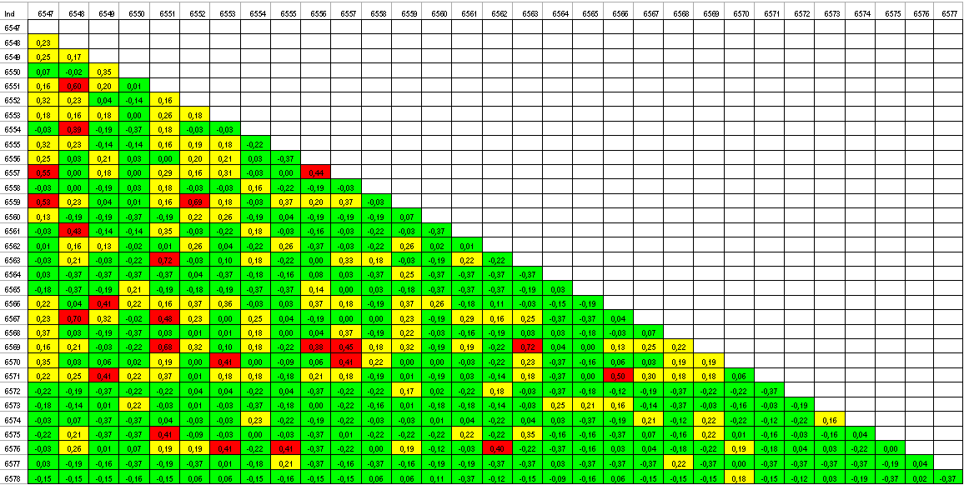
FIRST BREEDING PROGRAMS: THE TURBOT
In 1995 the first microsatellite tool used in the Spanish Aquaculture were developed to support broodstock organization and genealogical tracing in a family breeding program starting in 1991 in Stolt Sea Farm SA

Slide 31
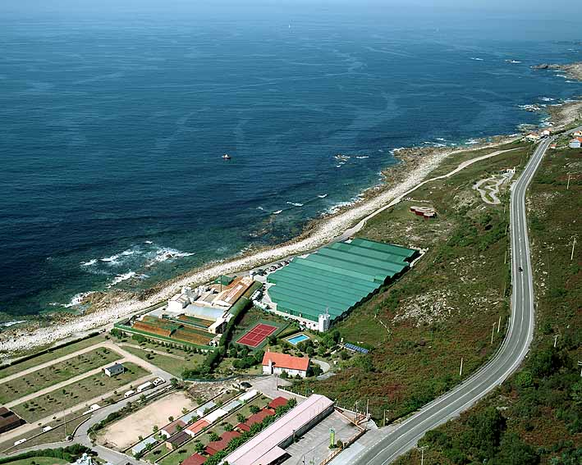
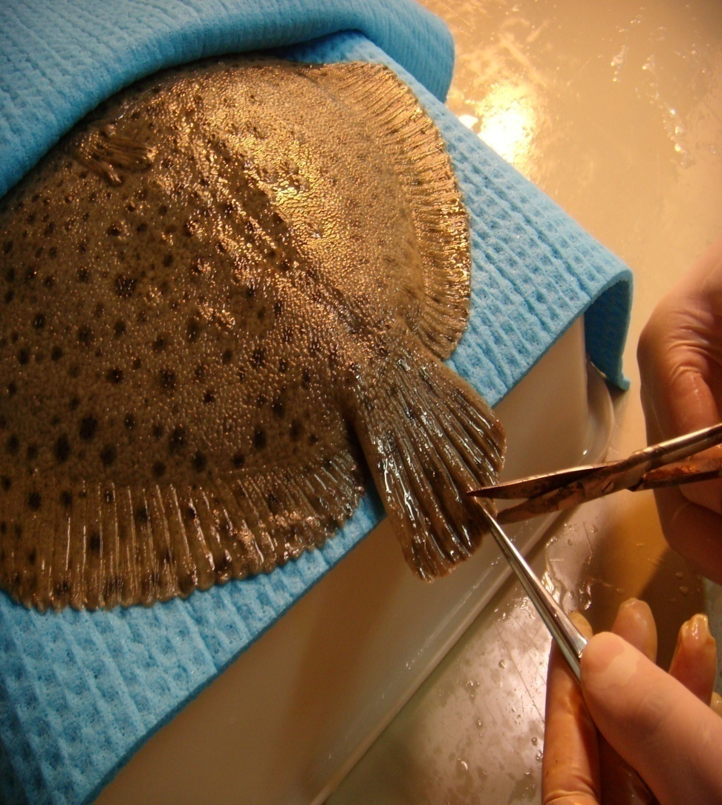
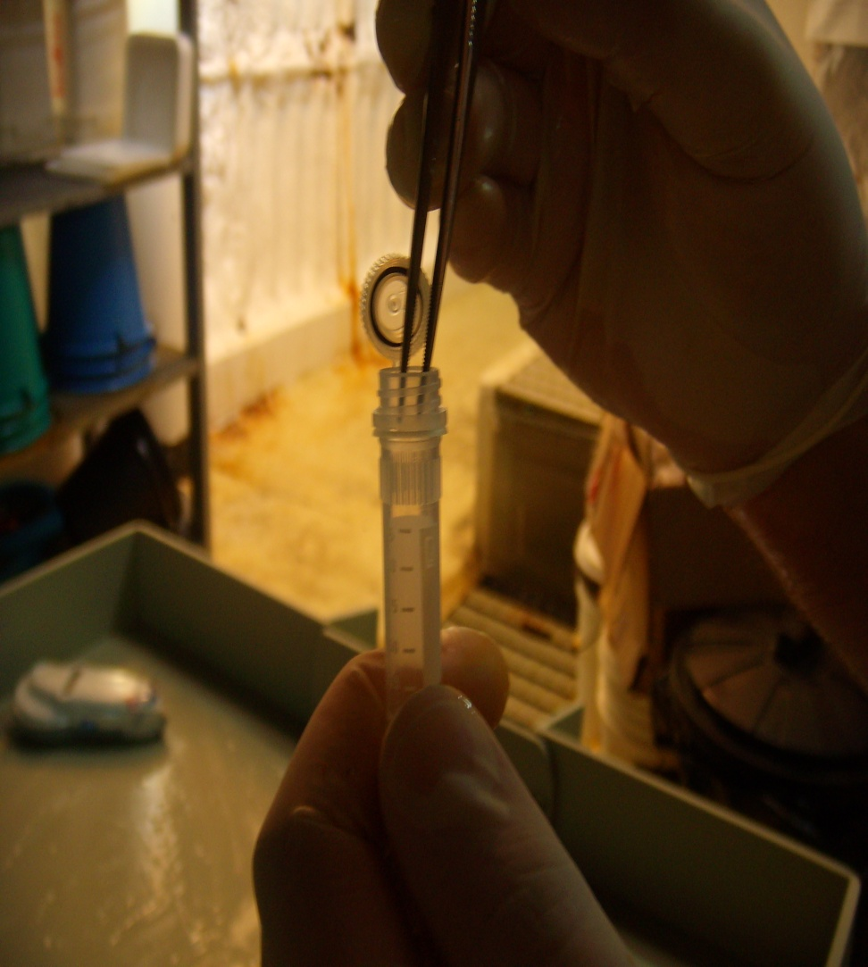
TURBOT BREEDING PROGRAMS.I
INSUIÑA S.A.
In 1999 Insuiña SA (filial of Pescanova SA) begins a masal selection program supported bymolecular markers

Slide 32



MAIN GENOMICS AQUACULTURE PROJECTS

Slide 33
THE TURBOT GENETIC MAP
LG01
LG02
LG03
LG04
LG05
LG06
LG07
LG08
LG09
LG10
LG11
LG12
LG13
LG14
LG15
LG16
LG17
LG18
LG19
LG20
LG21
LG22
LG23
LG24
Bouza et al (Genetics, 2007)

Slide 34
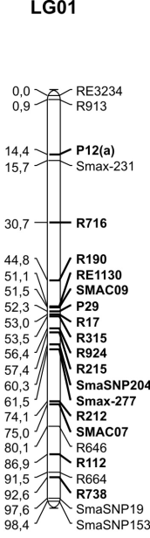
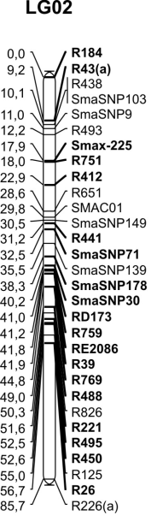
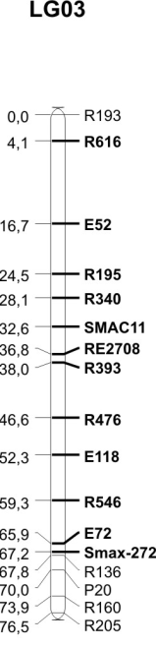
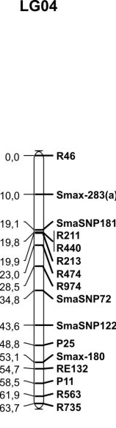
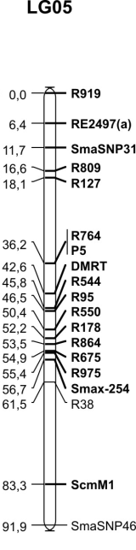
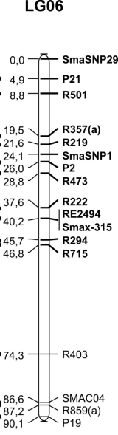
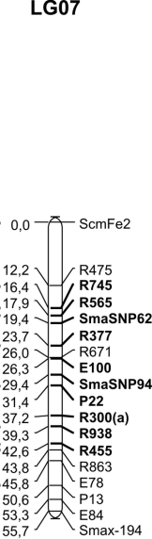

















GENOMIC ARCHITECTURE OF PRODUCTIVE TRAITS
QTL sex (Genetics, 2009)
QTLs growth (BMC Genomics, 2010)
QTLs resistance AS (BMC Genomics, 2011)
QTLs resistance PD (Animal Genetics, 2012)

Slide 35
FLATFISH ESTs DATABASES: SOLEAMOLD & TURBOTBASE
Sequences: Sanger/
NGS
sequences
Sequence data
BLAST homology
Quality assessment
Raw sequence, code, quality, edition
E- value
Cleaning and edition
Score
Alignment
Homology search
Clustering
Clustering
Systematic annotation
Group code
Sequences
Alignment
Consensus
Contigs and singletons
GO terms
KEGG pathways
Cerdá et al., BMC Genomics (2008)
Pardo et al., BMC Vet Res (2008)

Slide 36


FUNCTIONAL GENOMICS: EST DATABASES AND MICROARRAYS DEVELOPMENT

Slide 37
WHOLE GENOME SEQUENCING
Figueras et al. (in preparation)
Chen and Shao (poster presentation)
Manchado et al. (draft genome)

Slide 38











NEW BREEDING PROGRAMS: FISH

Slide 39
NEW BREEDING PROGRAMS: MOLLUSK
Flat oyster (Ostrea edulis)
Resistance to bonamia
Mussel (Mytilus galloprovincialis)
Toxin accumulation

Slide 40


